Slide 1
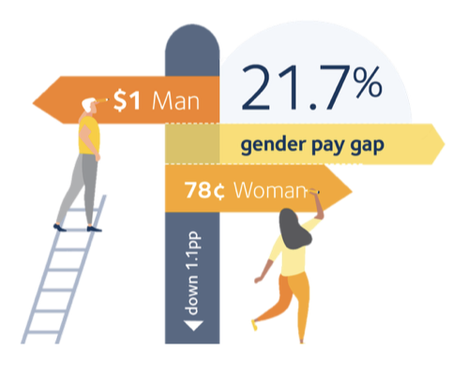
Exploring Gender Pay Disparities in Australian Industries
Presentation by:
Deepthi Suresh
S3991481
Image Source: (Workplace Gender Equality Agency (WGEA), 2024)

Slide 2
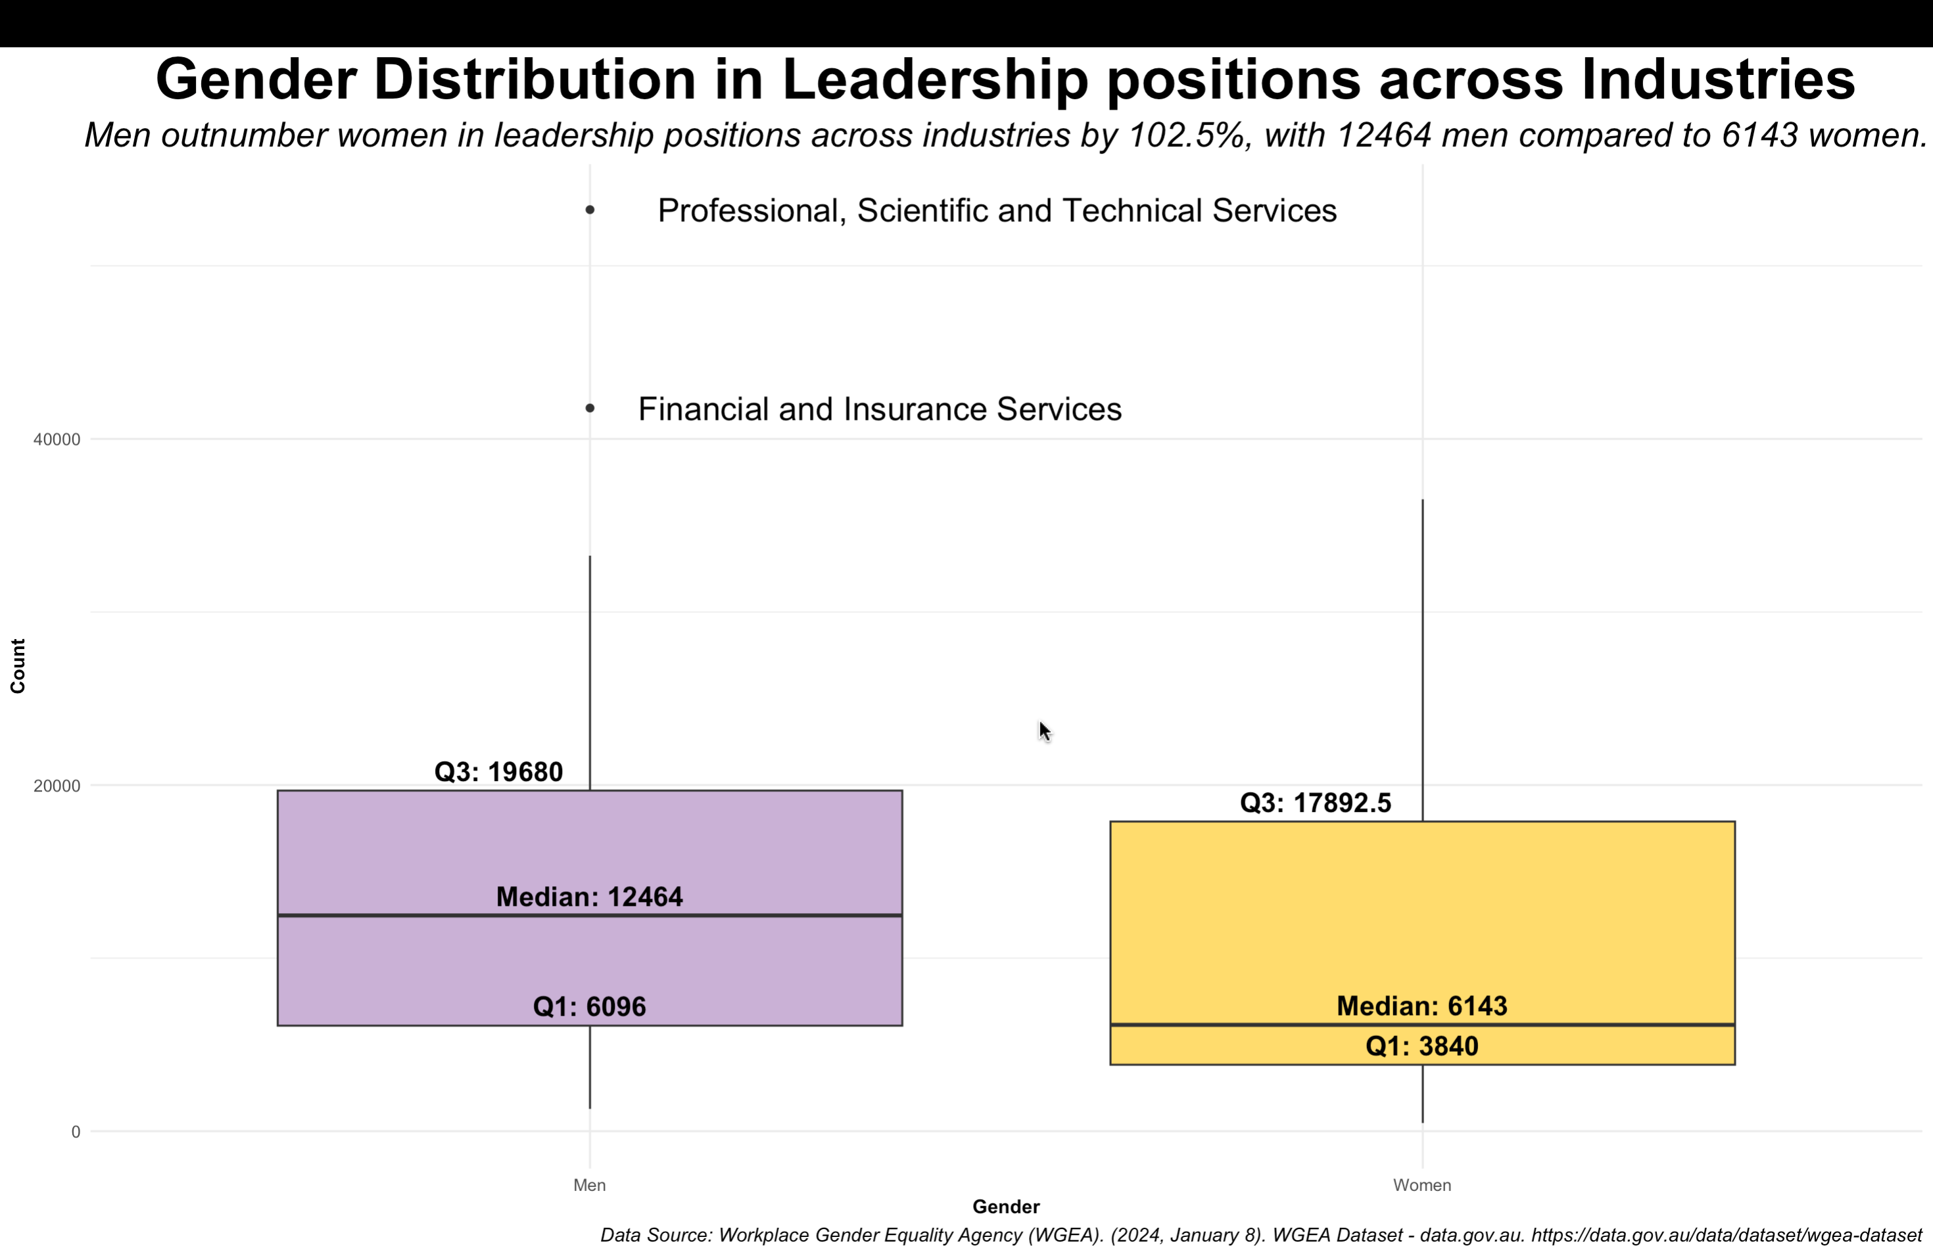
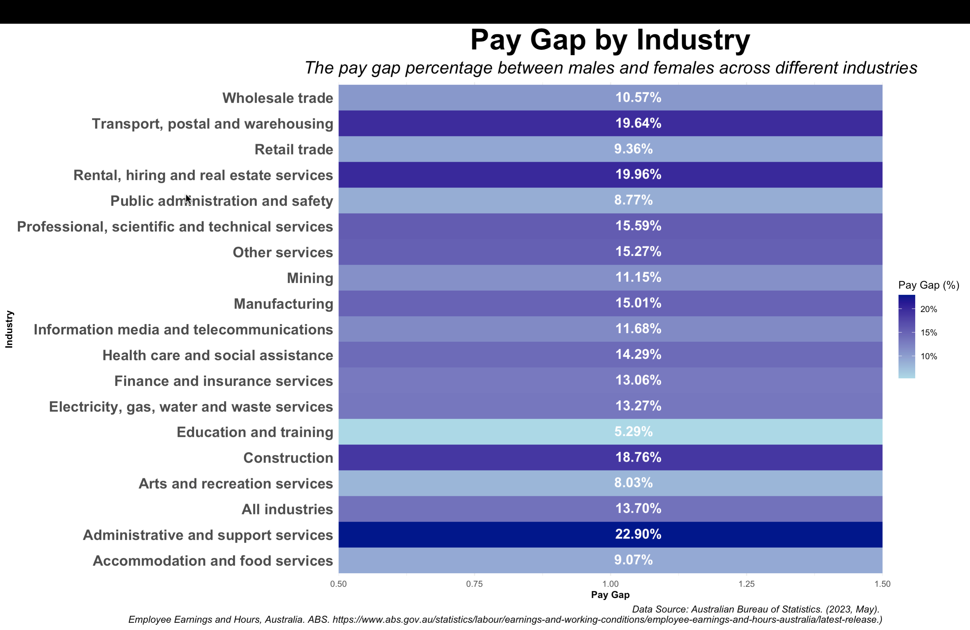
We all know gender pay gap exists, but how large is it?
In Australia, according to the WGEA, on average, for every $1 a man makes, a women earn only 78c. Administrative and support services has the highest pay gap of 22.90 % which means that the average weekly total cash earnings of a man in the indutry is 461 AUD more than a woman in the same industry
The leadership roles across all industries in Australia looks like they are male dominated with the number of men in managerial roles outnumbering women by 102.5%.

Slide 3
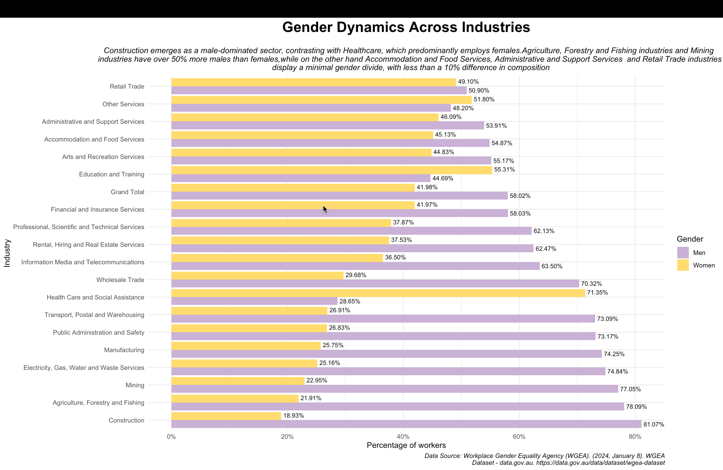
Key Highlights of Workforce Composition
Retail Trade and Other services industry shows near equal gender parity with less than 5 % difference.
Health Care and Social Assistance (71.35% women) and Education and Training (55.31% women) are heavily skewed towards female employees.
Construction (81.07% men), Agriculture, Forestry, and Fishing (78.09% men), and Mining (77.05% men) have significantly higher male representation, most likely due to the nature of the work.
Arts and Recreation Services (55.17% men), Accommodation and Food Services (54.87% men), and Administrative and Support Services (53.91% men) have more balanced, but still slightly male-dominated workforces.
Let’s take a deeper dive into the industries

Slide 4
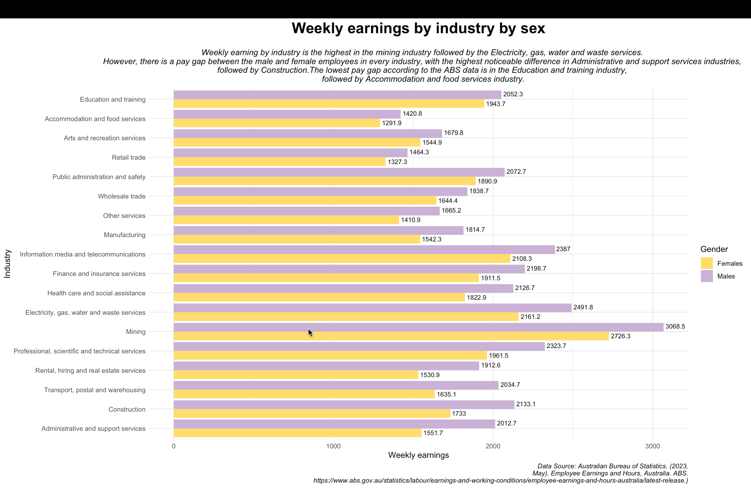
Key highlights
Healthcare: Despite being a female-dominated workforce, there's a 14.29% pay gap, with men earning on average 303 AUD more per week than women.
Administrative and Support Services: Women earn 461 AUD less than men, despite nearly equal workforce distribution.
Low Pay Gap Industries: Public administration and safety, retail trade, arts and recreation services, accommodation and food services, and education and training have pay gaps below 10%.
Education and Training: This industry has the most balanced gender distribution and the lowest pay gap at 5.29%, with men earning 108 AUD more per week.
Construction, Transport, Postal, and Warehousing, Rental, Hiring and Real Estate Services: Women in these male-dominated industries earn on average 393 AUD less per week than men.
In 2024, according to ABS, median weekly earnings for a man is $1,509 and $1,130 for a women, a difference of 379 AUD

Slide 5
Some examples of contributors to the gender pay gap
According to a study by Harvard Business Review (Zenger, 2021), women scored at a statistically significantly higher level than men on most leadership competencies, yet the number of women in leadership roles are declining. This could be because of hiring bias, where employers tend to think that men are more competent.
Women tend to prefer working in casual/part-time roles (57.34%) over full time roles (42.66%) to maintain a better work-family-life balance (Workplace Gender Equality Agency (WGEA), 2024).
Most of the female-dominated industries have lower wages potentially due to gender bias
Women in general are considered the caregivers of the family, and therefore take time off work to perform unpaid caring and domestic work. In some industries the number of primary carers leave taken by women are almost 4 times more than men
A lack of policies in the industries/organisation that actively addresses the issues at the root level.
In most industries, the high-profile leadership roles are occupied by men, which indicates that women are in low paying jobs in these industries, which further widens the gender pay gap.
Notes:
https://www.futurewomen.com/hotlists/5-reasons-gender-pay-gap-exists/
Parenthood leads some women to put their careers on hold, whether by choice or necessity, but it has the opposite effect among men.

Slide 6
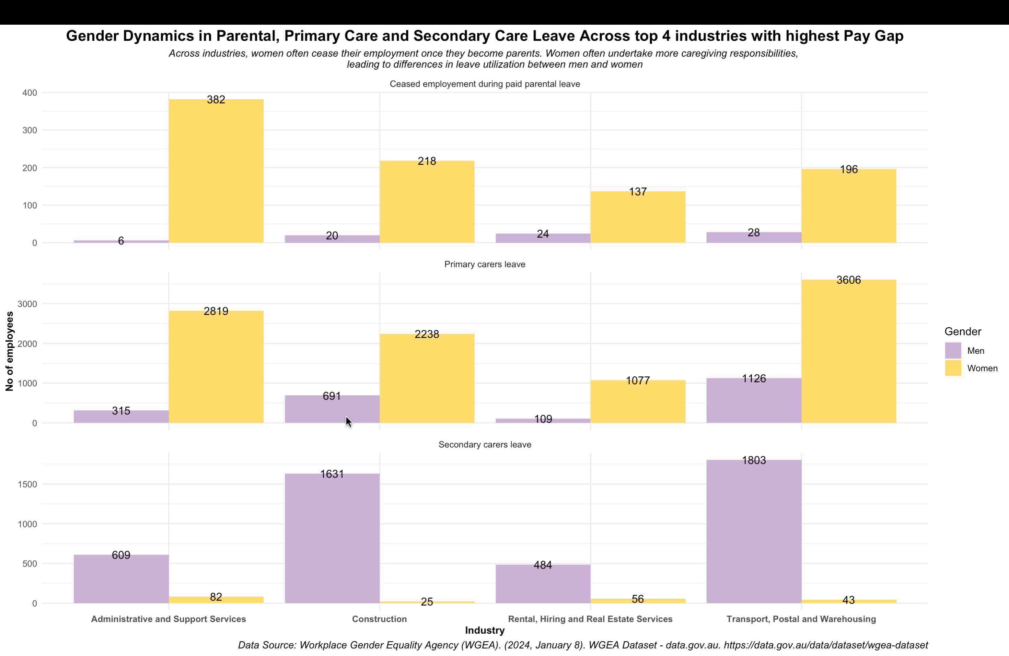
Key highlights
Across all industries, there appears to be a notable difference in the number of men and women who cease employment during paid parental leave, with women consistently having higher numbers in this category.
The number of employees taking primary carers leave is higher for women compared to men. In Administrative and Support Services industry, women apply for primary leave 4 times more than men apply for secondary leaves, showing how the caregiving responsibility majorly lies among the women
In Construction industry men seem to take on more secondary carers leave compared to other industries, while in Transport, Postal and Warehousing industry, women have a higher utilization of primary carers leave

Slide 7
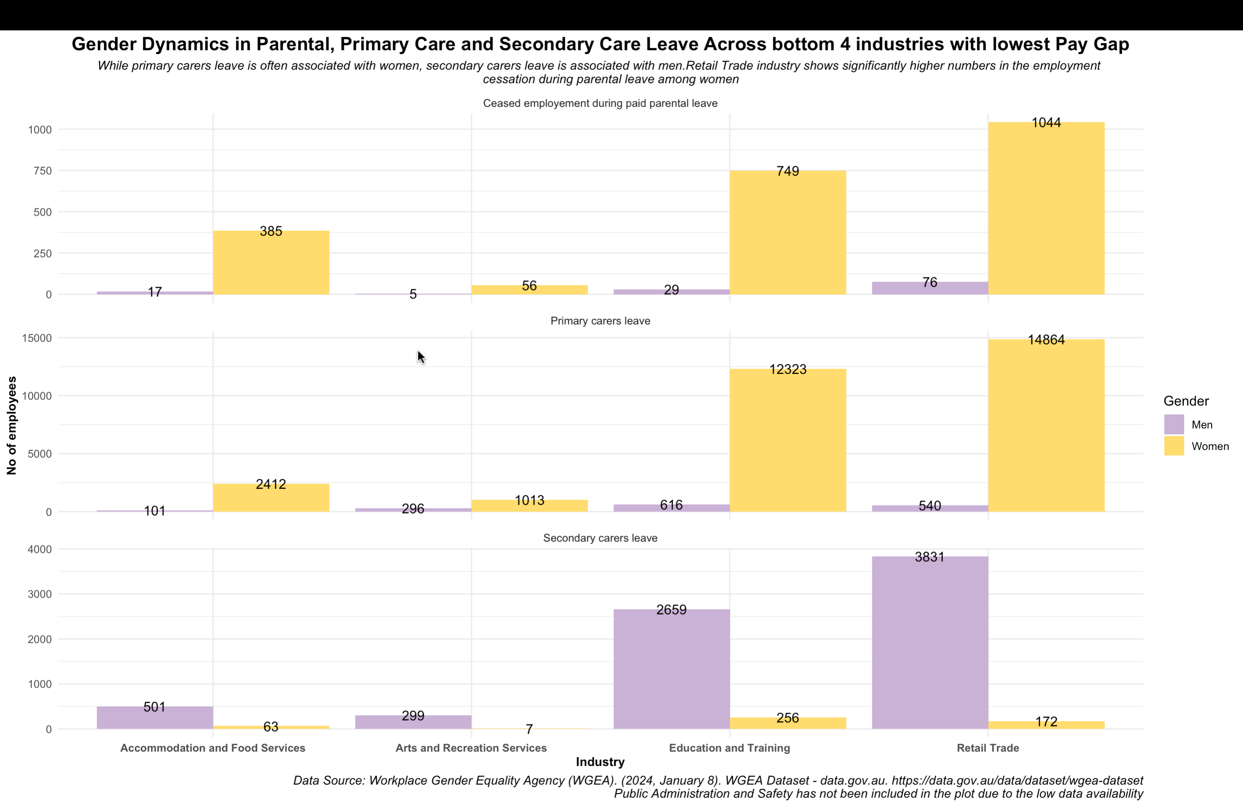
Key highlights
With lower pay gaps, these industries may exhibit more equitable leave utilization between men and women.
Women still dominate as primary carers, but the gap between men and women taking this leave is smaller compared to industries with higher pay gap.
Education and training industries have higher number of women who take primary carers leave and ceased employment during paid parental leave, despite having an almost equal gender composition.
Retail trade industry has significantly higher number of men taking secondary leave compared to other industries with low gender pay gap

Slide 8
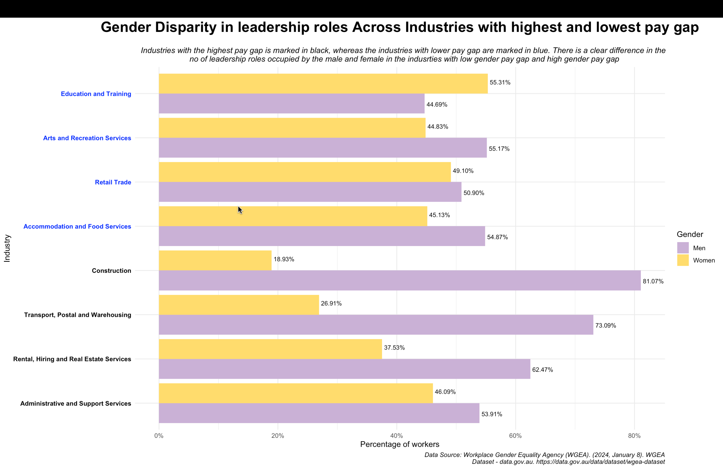
Key highlights
Industries with lower gender pay gap, tend to have a balanced distribution of men and women in leadership positions.
Administrative and Support Services industry, despite of having a comparatively low difference in the number of men and women in the leadership position, has the highest gender pay gap of 22.09%
In the construction industry, men hold 81.07% of the leadership positions which is 62% more than women’s numbers
69.67 % of the leadership positions in the 4 industries with the highest pay gap (combined) are occupied by men.

Slide 9
Suggestions to improve gender disparity
More facts …
In Mining Industry, 78.01% of the leadership positions are occupied by men
In Health Care and Social Assistance, 78.51% of the leadership positions are occupied by women.
Provide more training and development programs to women to support their transition to leadership roles
Engage more “Back to workforce” programs for women who wish to come back to the industry after a career break
Provide equal leave policy for new parents irrespective of their gender
Protection from sexual harassment by implementing Zero tolerance policy and POSH guidelines
Ensure pay gap transparency across industries so that employees can negotiate their wages
Gender disparity exists across all industries. Some more than others. It’s time to make a change!
66.89% of the men work in full time jobs whereas only 42.66% of the women work in full time. 52.34% of women prefer working in a part-time/ casual position. This could be to balance out their caregiving responsibilities.
In the construction industry, 82.89% of the movement by promotion were by the men.
The highest number of resignations amongst women were in the Health Care and Social Assistance at a 78.89%, and in the Mining industry for the men at 79.42%

Slide 10
References
Average Weekly Earnings, Australia, November 2023. (2024, February 22). Australian Bureau of Statistics. https://www.abs.gov.au/statistics/labour/earnings-and-working-conditions/average-weekly-earnings-australia/latest-release#article-archive
Employee Earnings and Hours, Australia, May 2023. (2024, February 21). Australian Bureau of Statistics. https://www.abs.gov.au/statistics/labour/earnings-and-working-conditions/employee-earnings-and-hours-australia/latest-release#data-downloads
GDPR message - Future Women. (2021, March 15). Future Women. https://www.futurewomen.com/hotlists/5-reasons-gender-pay-gap-exists/
Gender pay gap guide. (n.d.). Australian Bureau of Statistics. https://www.abs.gov.au/statistics/understanding-statistics/guide-labour-statistics/gender-pay-gap-guide#i-m-looking-for-gender-pay-gap-by-
Ortiz-Ospina, E., Hasell, J., & Roser, M. (2024, March 18). Economic inequality by gender. Our World in Data. https://ourworldindata.org/economic-inequality-by-gender
WGEA Data Explorer | WGEA. (n.d.). https://www.wgea.gov.au/data-statistics/data-explorer
Workplace Gender Equality Agency (WGEA). (2024, January 8). WGEA Dataset - data.gov.au. https://data.gov.au/data/dataset/wgea-dataset
Zenger, J. (2021, September 17). Research: Women score higher than men in most leadership skills. Harvard Business Review. https://hbr.org/2019/06/research-women-score-higher-than-men-in-most-leadership-skills#:~:text=According%20to%20an%20analysis%20of,from%20average%20or%20poor%20ones.

